Slide 1

AI and Machine Learning for IoT Big Data

Slide 2
AI for prediction

Slide 3
Lecture 5: Prediction with AI
Learning from samples
Supervised learning algorithms
Multi-layer neural networks
Support Vector Machines
Deep Learning for prediction

Slide 4
What is “learning”?
In the context of prediction, learning is the creation of a function for estimating an unknown variable
The function should minimize the expectation of the error of estimation
The function should use available observations and possibly a-priori knowledge about the domain

Slide 5
What functions to use?
Traditional regression: use a linear estimate mapping observed inputs to observed outputs
“Learning” for regression: least mean squares
Neural networks: use nonlinear functions with biologically inspired structures
“Learning” for neural networks: many heuristic procedures

Slide 6
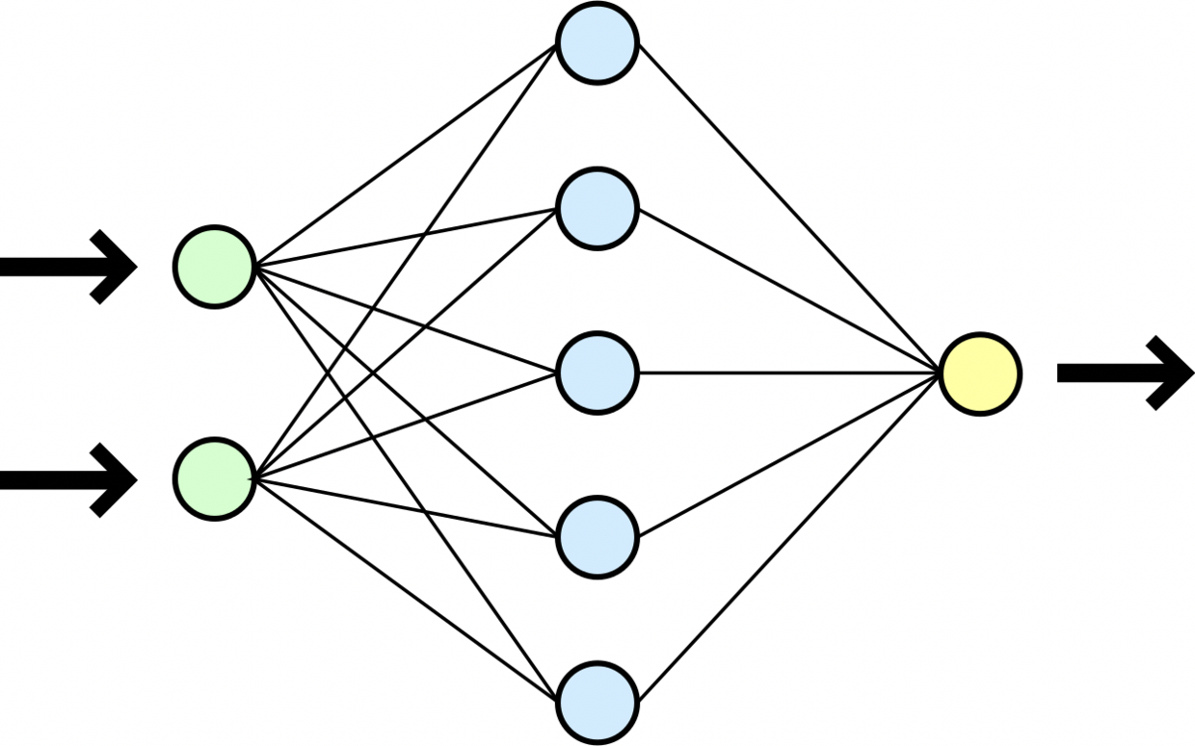

Multi-Layer Perceptron
By Dirk Hünniger (Own work) [CC BY 3.0 (http://creativecommons.org/licenses/by/3.0)], via Wikimedia Commons
Example with 2 inputs, 1 output, 1 hidden layer
The lines indicate “connections” or “synapses”

Slide 7
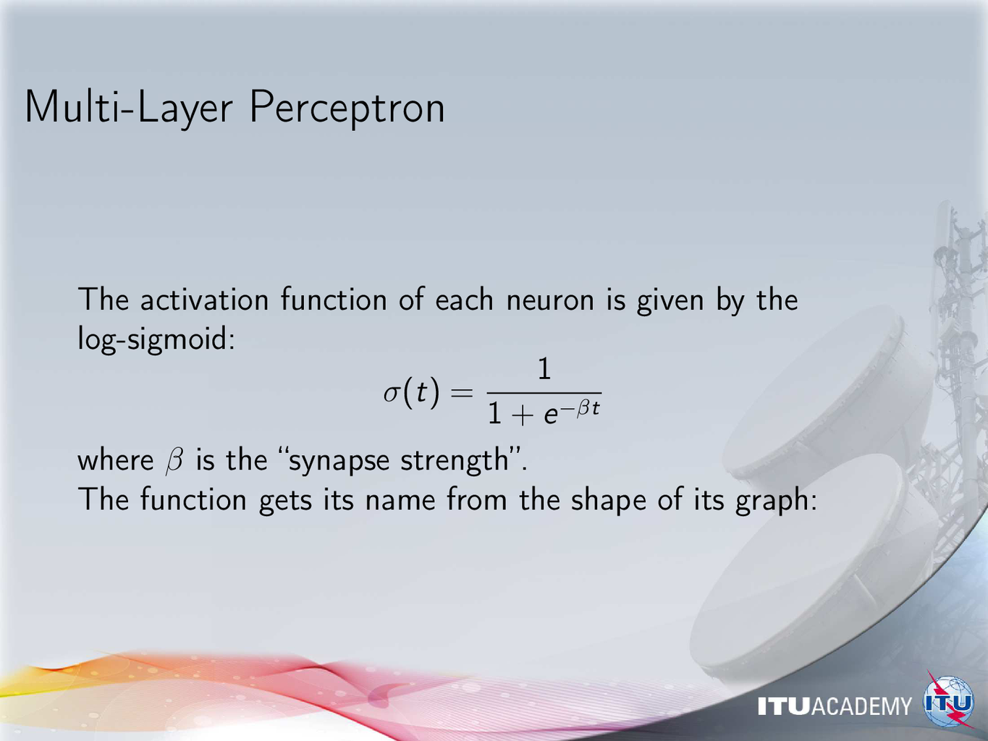

Slide 8
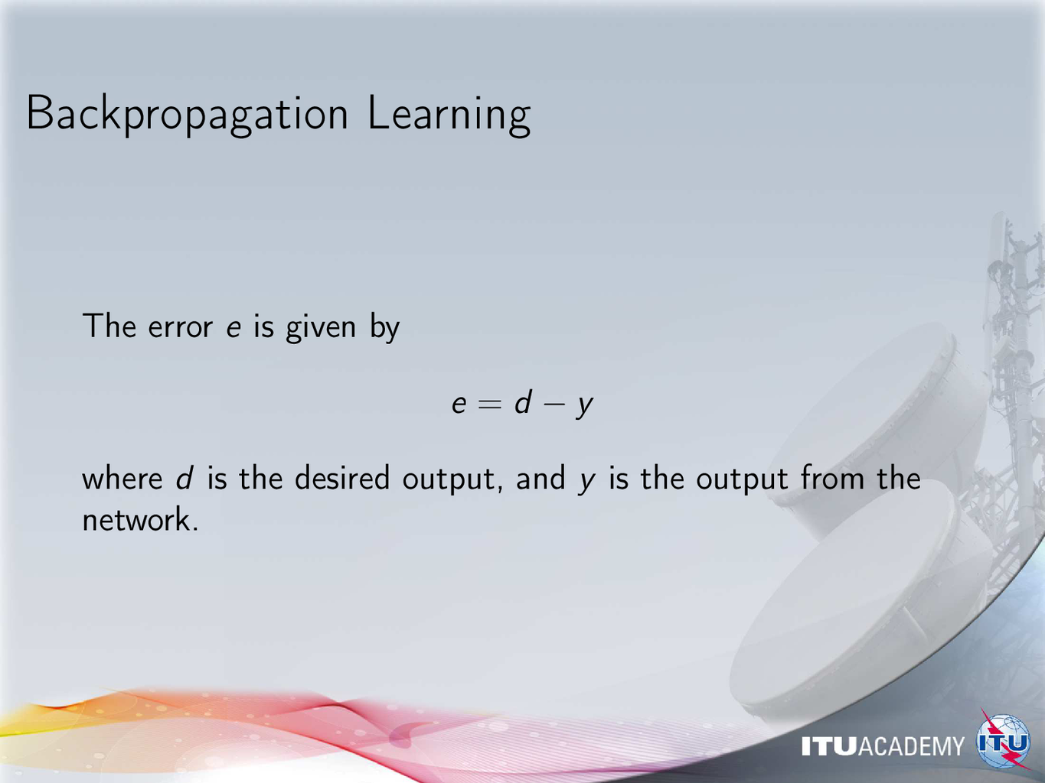

Slide 9
Support Vector Machine
https://commons.wikimedia.org/wiki/File:Svm_10_perceptron.JPG
Finding the separating hyperplane between classes
even when there is no linear separation

